Slide 1
OBJECT ORIENTED
ANALYSIS AND DESIGN
Ch - 2
A study material for the students of GLS University

Slide 2
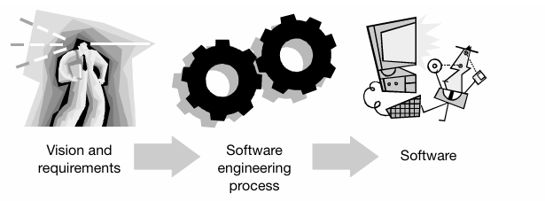
What is Unified Process?
The Unified Process (UP) is a method or way of developing software in a well-planned and organized manner.
It helps software teams to:
Understand what to build,
Design it properly,
Build it step by step,
And deliver it to users successfully.
SEP is the process in which user requirements convert into software

Slide 3
UML project was meant to provide both visual language and software engineering process
UML is visual language and UP is the process part
UP is based on process work conducted by Ericsson approach at Rational
UP method for developing software and incorporates best practice from its predecessors

Slide 4
The Birth of UP
Ivar Jacobson, father of UP
In 1967 the Ericsson Approach, modeling a complex system as a set of interconnected blocks
Small blocks were interconnected to form large blocks building up to a complete system
The basis of this approach was “Divide and conquer” and now as component-based development

Slide 5
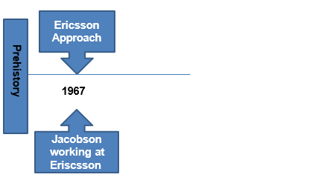

Slide 6
Another Ericsson innovation was, these blocks creating “traffic cases” that described how system to be used – which called use cases in UML
The result of this process was an architecture representation that described the blocks and how they fitted together
The requirement view (traffic cases) and static view (architecture description), Ericsson had a dynamic view that described how all the blocks communicated with each other
This consist of sequence, communication and state machine diagram

Slide 7
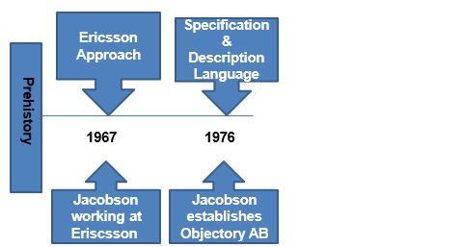
Next development in 1980s of Specification & Description Language (SDL) was one of the first object-based visual modeling language
In 1992 it was extended to become object-oriented with classes and inheritance

Slide 8
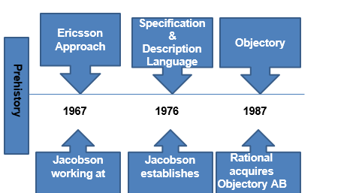
In 1987, company develop and sold a software engineering process, based on Ericsson approach called Objectory
It basically consist of Documentation and tools needed by objectory

Slide 9
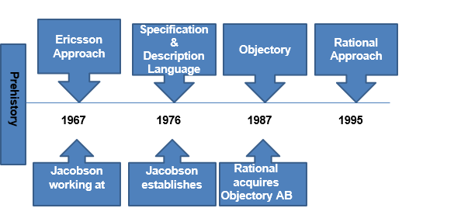
Objectory acquired by Rational in 1995, objectory process with large amount of process related work that already been done by rational
“4+1 view” was developed

Slide 10
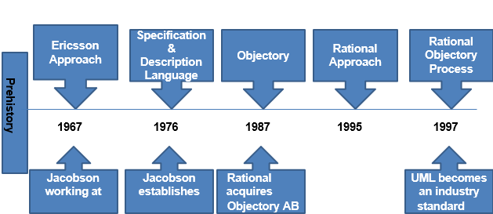
The Rational Objectory Process (ROP) was the result of the unification of Objectory with Rational’s process work

Slide 11
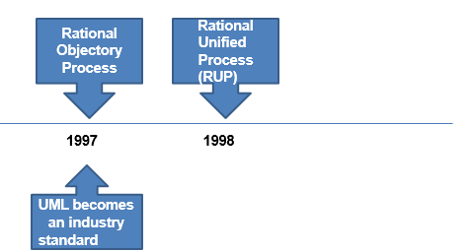
In 1997, Rational acquired many more companies bringing in expertise in requirements capture, configuration management, testing
This led to the release of Rational Unified Process (RUP) in 1998

Slide 12
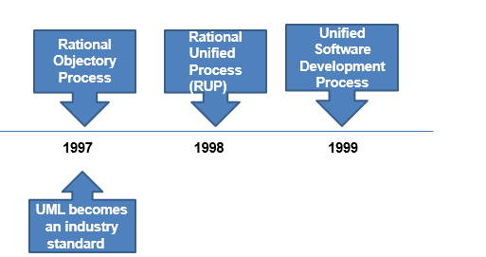
In 1999,the Unified Software Development Process, which describe the Unified Process

Slide 13
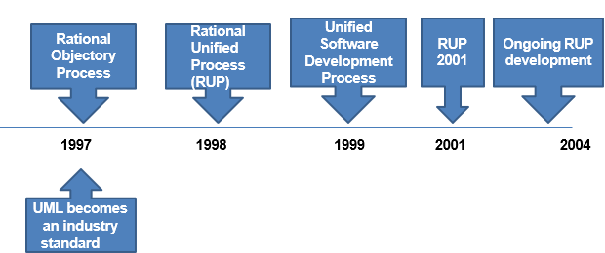
RUP is Rational Process Product and UP is an open SEP Software Engineering Process
Both are closely related

Slide 14
UP Axioms
UP axioms are the fundamental principles or guiding rules of the Unified Process (UP).
Use-Case Driven
Architecture-Centric
Iterative and Incremental
Risk Focused
Model Driven

Slide 15
Use-Case Driven –
Use cases help define system behavior and ensure that development focuses on fulfilling user needs.
All development activities—from design to testing—are tied back to use cases.
2. Architecture-Centric –
How system divided into components
How those components interact
How Deployed on hardware

Slide 16
3. Iterative and Incremental –
Iterative, break the project into small subprojects that
deliver system functionality
- Increments, leading to a fully functional system or we
build software by a process of stepwise refinement to
our goal
4. Risk-Focused –
Early identification and mitigation of risks are key to success.
5. Model Driven –
Models guide coding, documentation, and communication among team members.
Emphasizes the use of visual models (e.g., UML diagrams) to represent system structure and behavior.

Slide 17
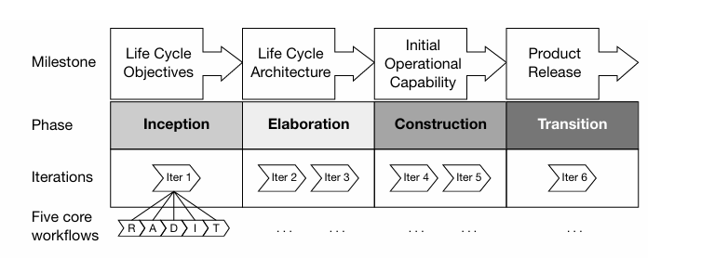
UP Structure

Slide 18
UP Structure
The product life cycle is divided into four phases
Inception, Elaboration, Construction and Transition - Each of which ends with major milestone
• Each phase contains one or more iterations
• Each iteration execute the five core workflows and any extra workflows

Slide 19
UP Structure
UP consists of a sequence of four phases, each of which terminates with a major milestone:
1. Inception – Life Cycle Objectives
2. Elaboration – Life Cycle Architecture
3. Construction – Initial Operational Capability
4. Transition – Product release

Slide 20
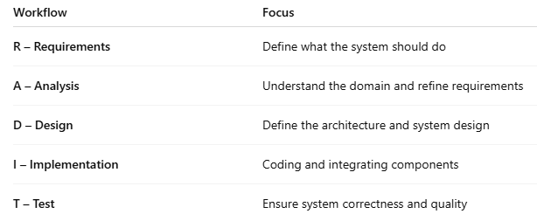
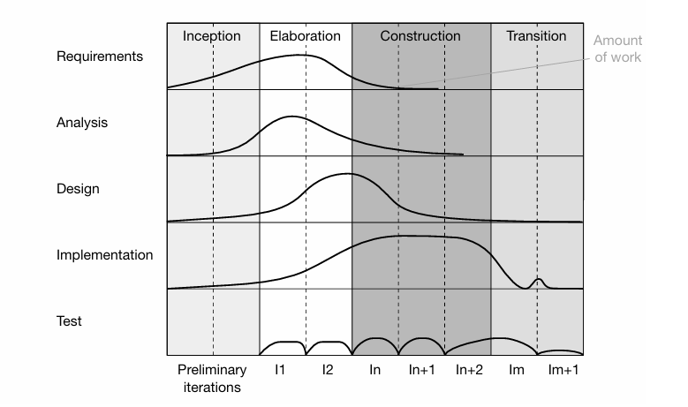
Core Workflows (R-A-D-I-T) :

Slide 21
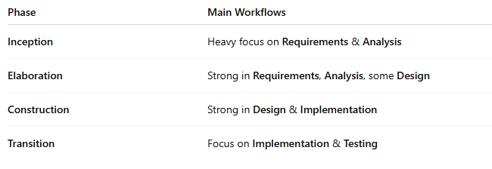
Workload Variation by Phase

Slide 22
UP Phases
Inception Phase – Inception is all about initiating the project
  Initiation involves establishing feasibility, creating a business case, capturing requirement and identifying critical risks
  Primary workers - project manager and system architect
  Focus on requirement and analysis workflow

Slide 23
2. Elaboration Phase –
Elaboration is about creating a partial but working version of the system – an executable architecture baseline
• Main goals
Create an executable architecture baseline
Create a detailed plan for the construction phase
Formulate resources, time, equipment, staff and cost
•Main Focus on Design workflow and other also refer

Slide 24
3. Construction Phase –
Construction evolves the executable architectural baseline into a complete, working system
• Goal of construction is to complete all requirement, analysis, and design and to evolve the architectural baseline generated in Elaboration into the final system
• Main focus on the implementation workflow
• System is ready for testing at user site

Slide 25
4. Transition Phase –
Transition is about deploying the completed system into the user community
• This phase starts when testing is completed and the system is finally deployed
• Goals of this phase – prepare the user sites for the new software, modify the software, create user manuals and other documentation
• Main focus on test workflow

Slide 26
iterative and incremental process
The Unified Process (UP) is fundamentally an iterative and incremental software development framework designed to tackle complex projects by breaking them into manageable parts and evolving the system step by step.
Iterative -
development in repeatable cycles (iterations).
Each cycle encompasses planning, analysis, design, implementation, integration, test, and often a release.
After each cycle, you review, refine, and improve the work.
Ex- drafting multiple versions of an essay—refine at each version.

Slide 27
Baseline -
• Each iteration generates a baseline
• That Comprises a partially complete version of the final
system and any associated project documentation
• Baselines build on each other over successive iterations until the final finished system is achieved

Slide 28
Incremental -
building the system piece by piece.
Each new “increment” adds new functionality to the previous baseline.
Over time, these increments sum up to a complete system.
The difference between two consecutive baselines is known as an increment

Slide 29
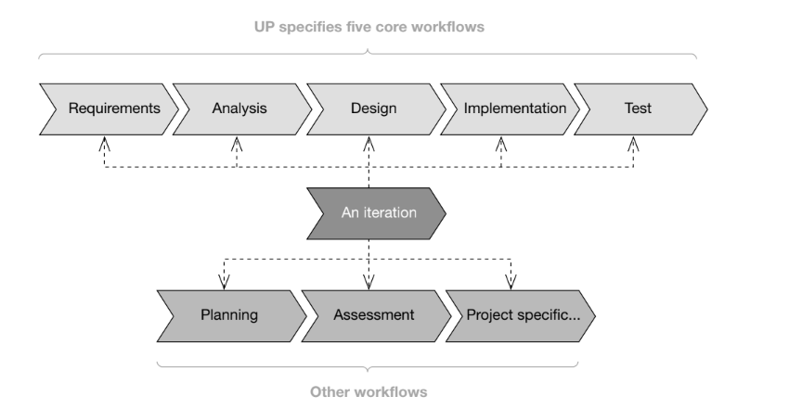
Iteration Workflows -

Slide 30
Iterations & Baselines -
Each iteration produces a baseline—a partially complete version of the system, along with documentation.
Each baseline provides an agreed basis for further review
and development
Can be changed only through formal procedures of configuration and change management
Increments are just the difference between one baseline and
the next
Think of baseline as a saved game. If something goes wrong, you can reload it. And incremental means you keep upgrading your game level by level, without restarting.

Slide 31
MCQs
1.Which phase of UP defines the system architecture? a) Inception b) Elaboration c) Construction d) Transition
Answer: b) Elaboration
2. The main goal of the Inception phase is: a) To deliver the final product b) To capture 100% of requirements c) To check feasibility and define scope d) To write complete code
Answer: c) To check feasibility and define scope

Slide 32
MCQs
3. In which UP phase is the software deployed to the user environment?
a) Construction b) Transition c) Inception d) Elaboration
Answer: b) Transition
4. Which of the following is a milestone of the Construction phase? a) Product Release b) Life Cycle Objectives c) Initial Operational Capability d) Risk Resolution
Answer: c) Initial Operational Capability

Slide 33
MCQs
5.What is the main workflow focus in the Construction phase? a) Requirement Gathering b) System Design c) Implementation & Testing d) Deployment
Answer: c) Implementation & Testing
6.The final milestone of the Unified Process is: a) Life Cycle Architecture b) Product Release
c) Initial Operational Capability d) Vision Statement
Answer: b) Product Release

Slide 34
The Unified Process has three phases: Inception, Construction, and Deployment.
False
Elaboration phase ends with the milestone called "Life Cycle Architecture".
True
Requirements are completely frozen after the Inception phase.
False
The Transition phase involves testing and bug fixing.
True

Slide 35
Who is known as the father of the Unified Process?
Answer : Ivar Jacobson
2. Which phase includes most of the coding and testing?
Answer: Construction
3.Milestone achieved at the end of Elaboration?
Answer: Life Cycle Architecture
4. Final milestone of the UP?
Answer: Product Release

Slide 36
Real-World Analogy Exercise
Question:
Imagine you are someone responsible for the organizing of a college fest at your own campus or in the planning of a birthday party for one friend. Software development, likewise to the two events, needs planning, also coordination, plus execution.
Use your Unified Process understanding to explain how you would manage each of its four phases when you organize the event: Inception, Elaboration, Construction, Transition.
In your answer, describe:
In each phase, what activities or decisions take place then?
What type of information would you want to collect?
What are some problems you might anticipate and also how you make plans in order to deal with them
Each phase prepares you. That groundwork is what the following stage develops.

Slide 37
Opening a New Restaurant – Understanding UP Phases
Phase 1: Inception = Initial Idea & Business Plan
What type of restaurant? (fast food, fine dining, cafe?)
Who are your customers?
What’s your budget?
What’s your vision?
Phase 2: Elaboration = Designing & Planning
Finalize the menu
Design the kitchen and dining area
Plan staff and equipment
Handle safety and legal risks

Slide 38
Opening a New Restaurant – Understanding UP Phases
Phase 3: Construction = Building the Restaurant
Hire chefs and staff
Purchase equipment
Decorate the space
Test kitchen equipment and sample dishes
Phase 4: Transition = Opening & Feedback
Grand opening
Gather customer feedback
Fix service issues
Launch advertising

Slide 39
THANK YOU

